Slide 1
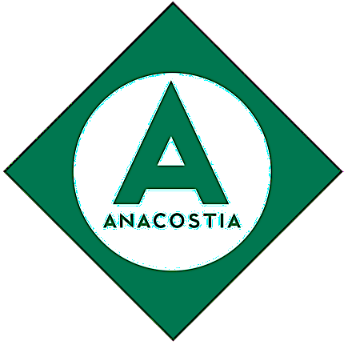

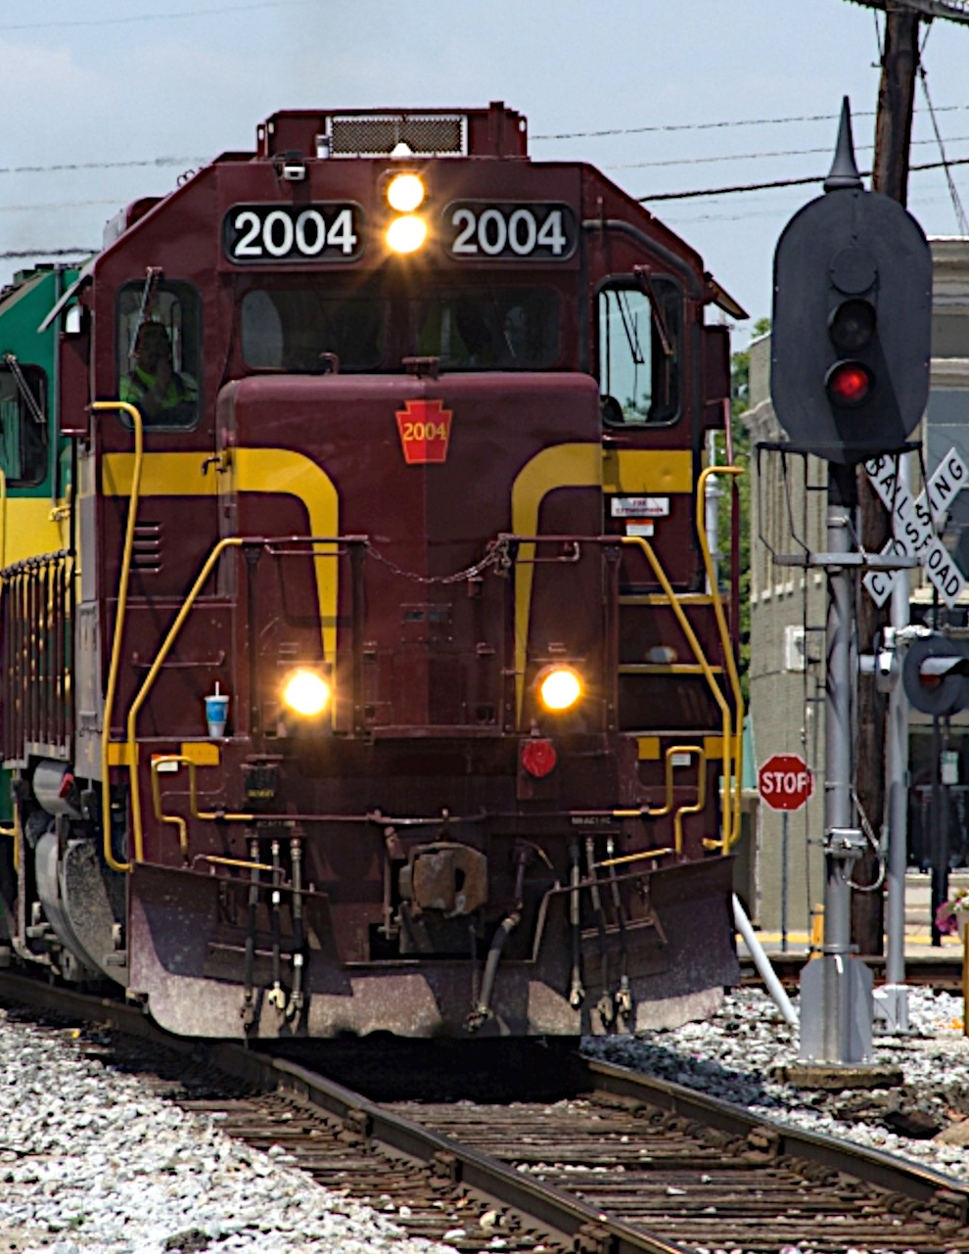
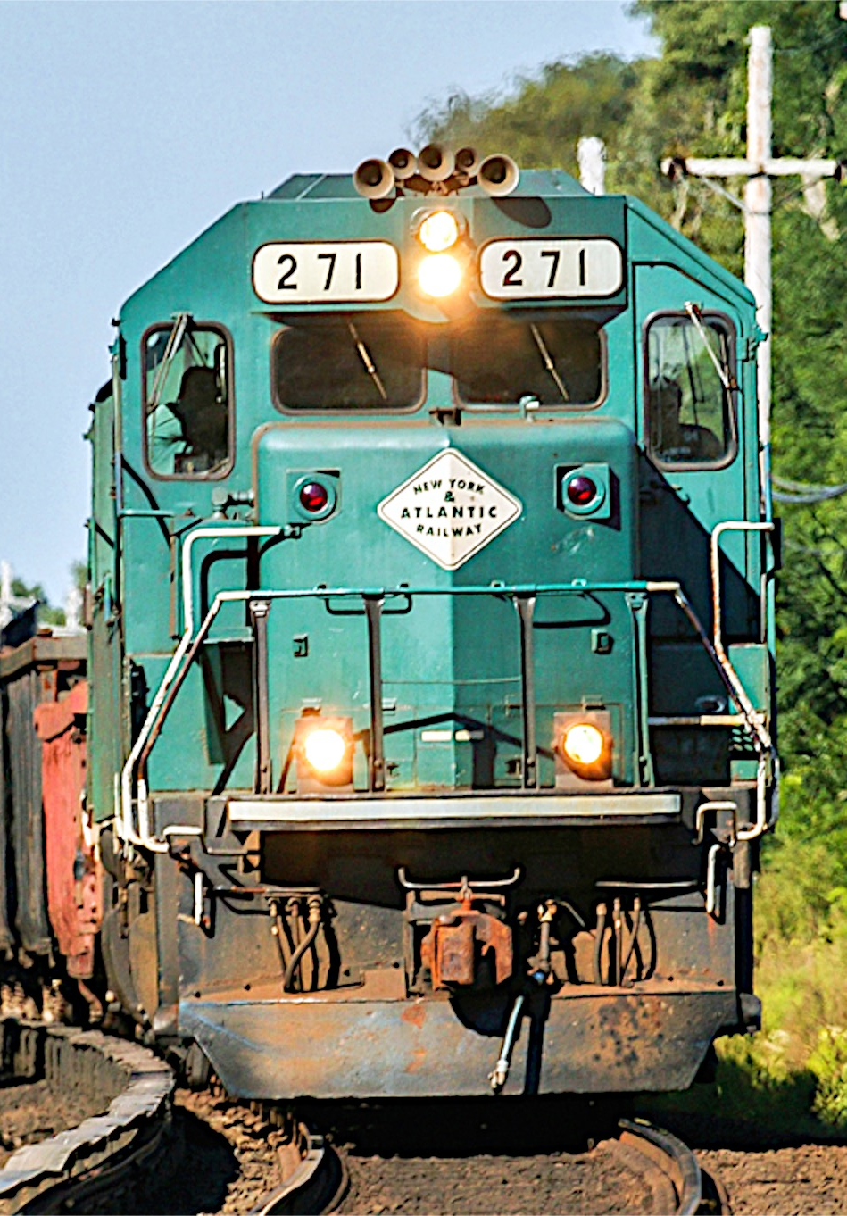
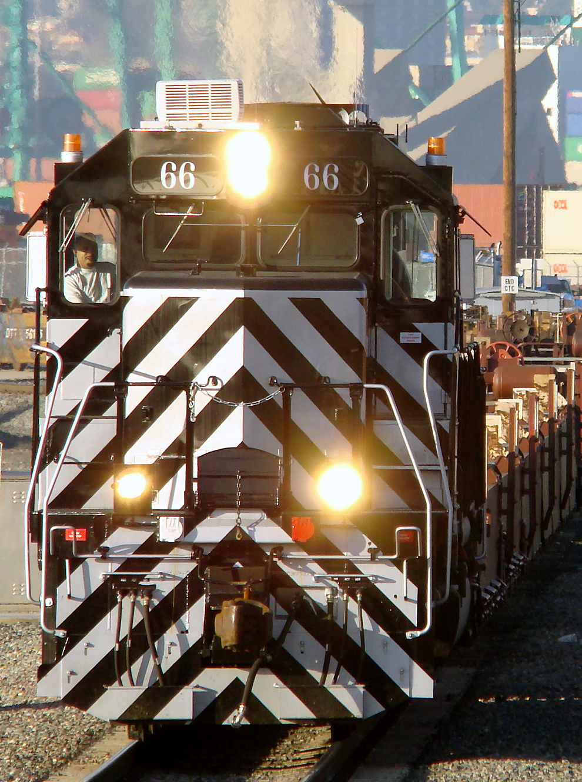
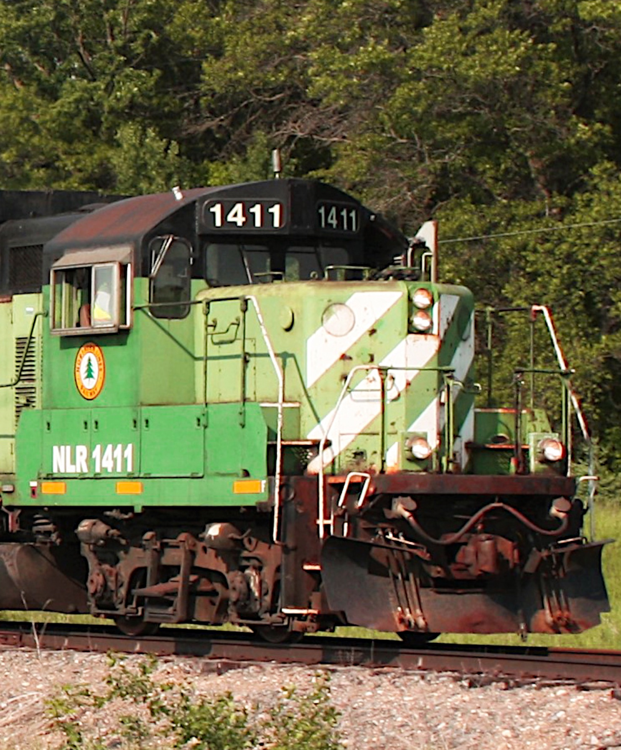
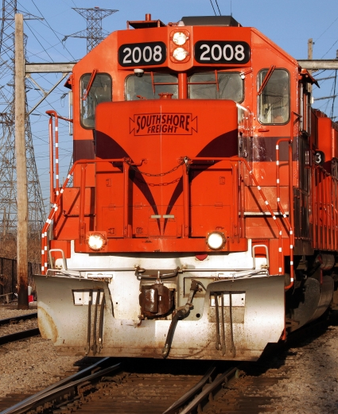
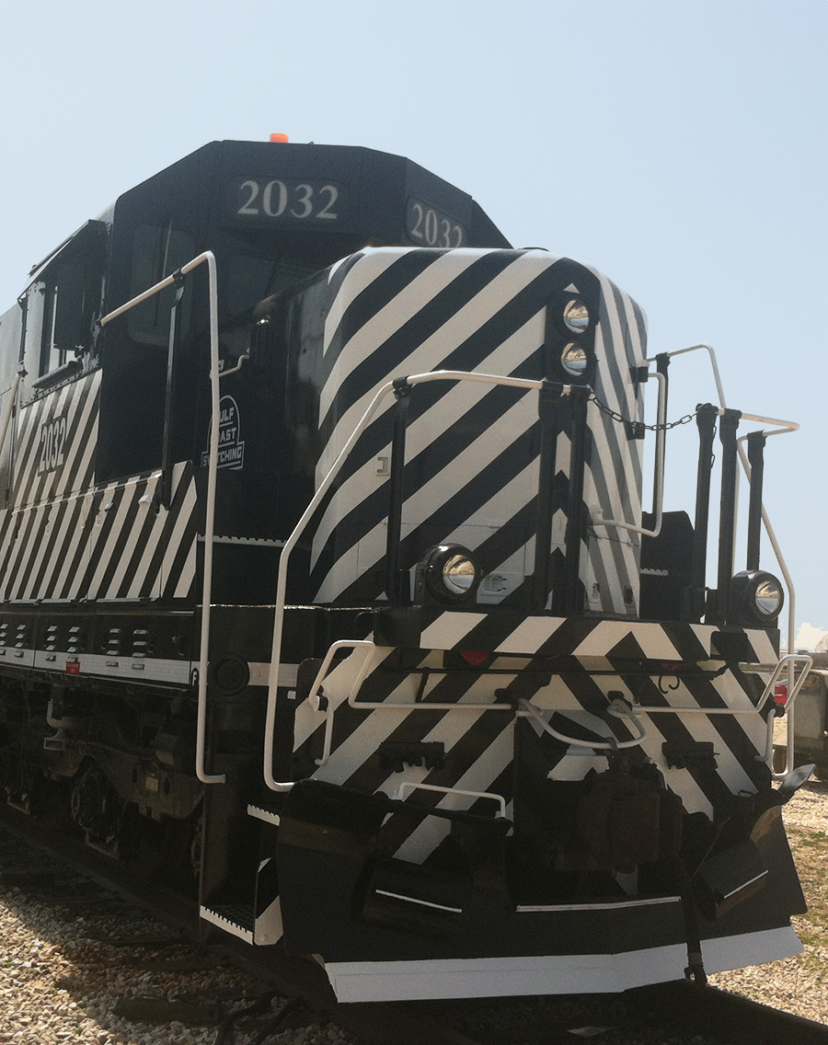

Slide 2
Northwestern Sandhouse 2018
South Shore Freight
Public Private Partnership
Success Story

Slide 3
Agenda
CSS &SB History
PPP
Challenges
Our Approach Moving Forward
Questions

Slide 4
Anacostia Experience in PPPs
Chicago South Shore
90 mile joint use with Northern Indiana Commuter Transportation District
Freight-passenger corridor with 50 daily passenger trains and
50,000 plus annual freight carloads-since 1990
New York & Atlantic
269 mile shared with Long Island Railroad
Freight-passenger network with 600+ daily passenger trains and
30,000+ annual freight carloads-since 1997
Pacific Harbor Line
Concession to operate publicly-owned
Ports of Los Angeles and Long Beach
Rail facilities in largest port complex in North America-since 1998

Slide 5
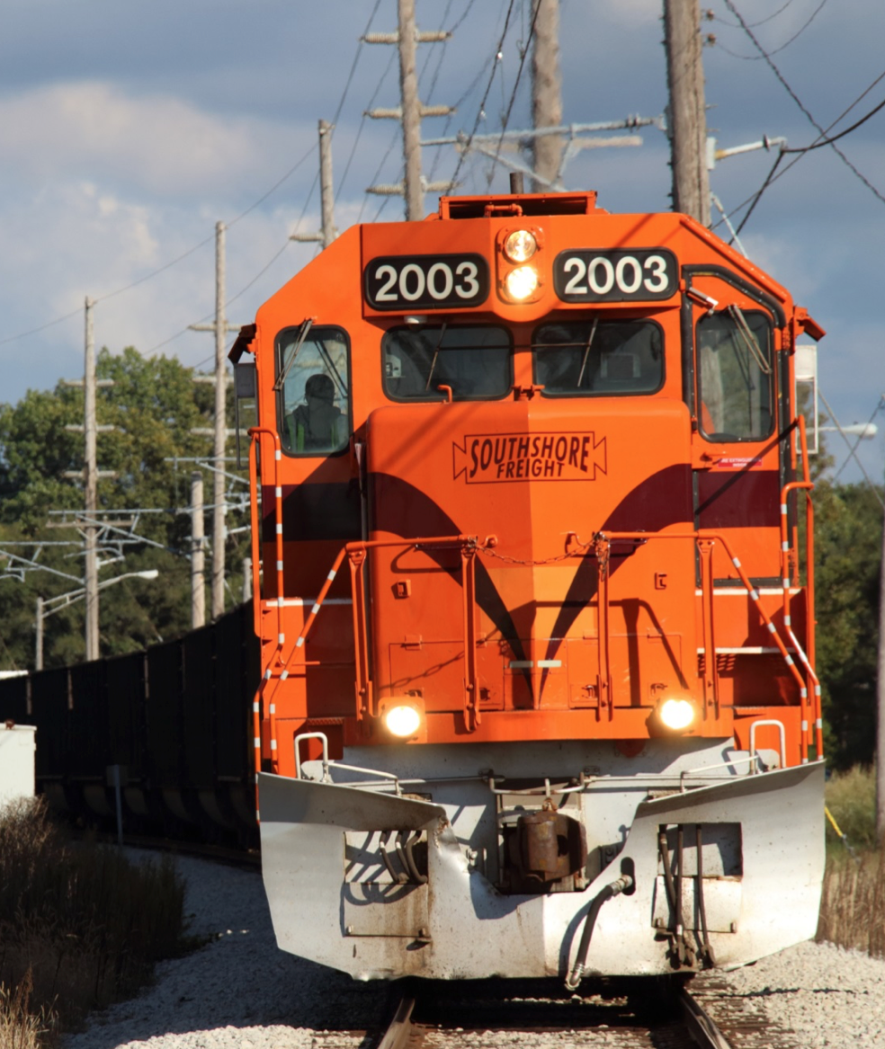

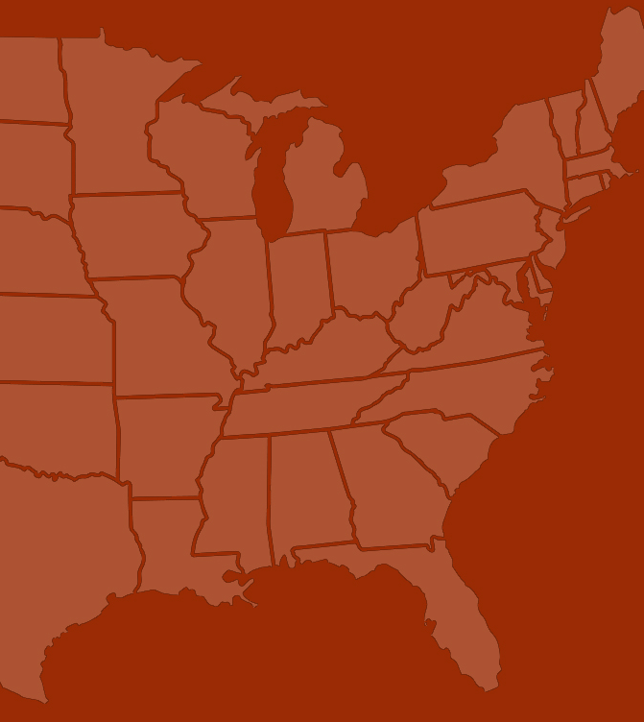
Chicago South Shore &
South Bend Railroad
75 mile joint use with Northern Indiana Commuter Transportation District
Freight - passenger corridor
43 daily passenger trains
50,000+ annual freight carloads since 1990

Slide 6
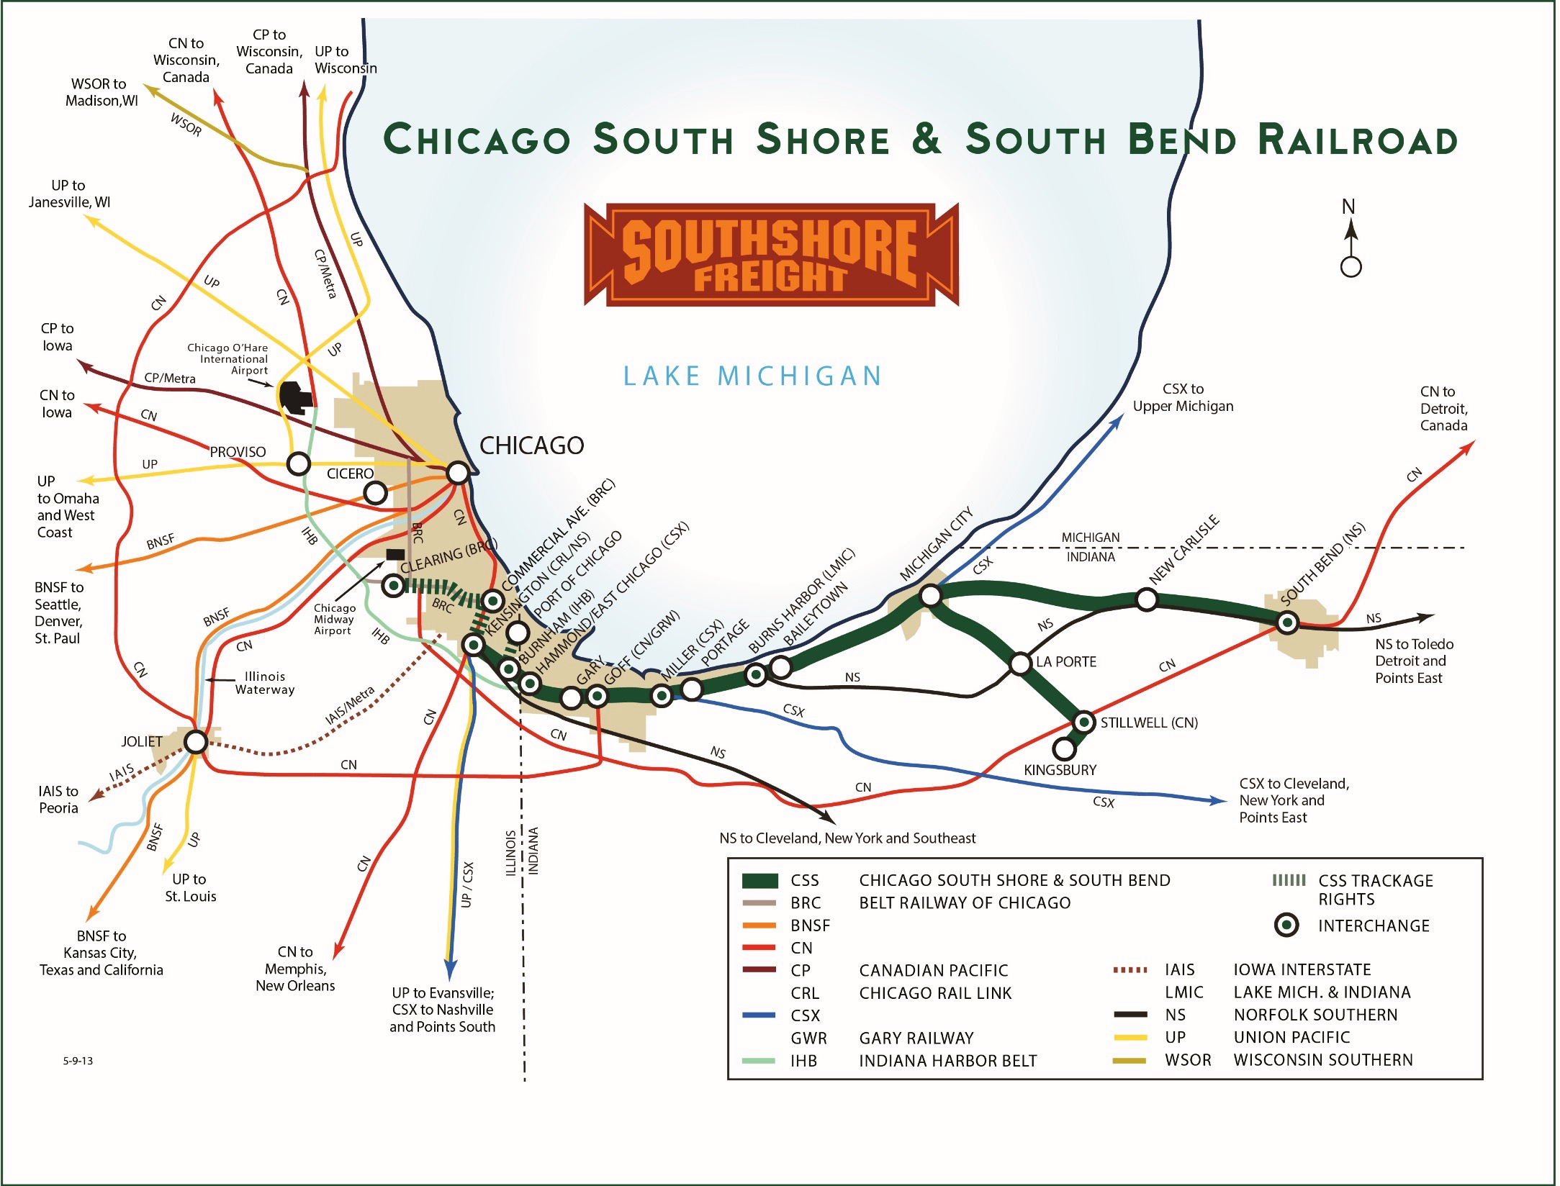
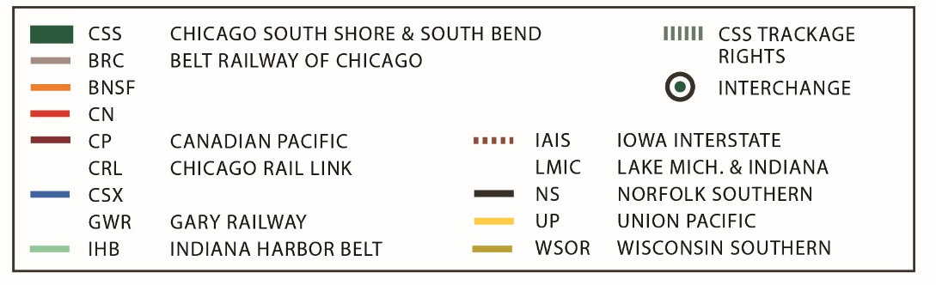
Chicago South Shore & South Bend Railroad

Slide 7
CSS: Vital Information
Established 1990, purchased from bankruptcy
Serves Chicago and Northwest Indiana
Connections All Chicago railroads (directly or via BRC)
Commodities Steel, coal, chemicals, building materials, grain, food products
Route Miles 100 (75 shared with NICTD)
Carloads 55,000
President Mr. Todd Bjornstad

Slide 8





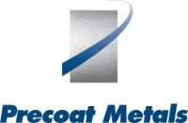

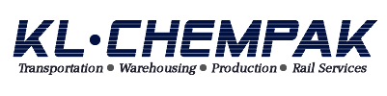








CSS: Customers
Steel/Metals
Fuel/Energy
Chemicals
Paper
Minerals
Lumber/Building

Slide 9
CSS: Structure
Public Partner:
Northern Indiana Commuter Transportation District (NICTD)
  Ownership of mainline, catenary and other joint use track infrastructure
  Dispatching and maintenance of joint use track
  All passenger operations
Private Partner:
The Chicago South Shore & South Bend Railroad (CSS)
  All common carrier freight operations; ownership of all freight locomotives and cars
  Ownership of certain joint use track infrastructure
  Maintenance/capital for freight-only track infrastructure

Slide 10
CSS: Structure
Anacostia formed new company to buy assets of bankrupt railroad.
Pursuant to agreement, responsibility for passenger operations transferred to transit agency that previously only subsidized service.
CSS assumed existing labor agreements.
Joint track ownership is a hybrid of CSS and NICTD ownership; where NICTD owns track, CSS has permanent property interest.
Joint track (regardless of ownership) maintained by agency, the entity with the highest track speed parameters.
Dispatching conducted by NICTD, but chief dispatcher position is “joint employee”.
CSS pays agency car mile fee for use of track owned by NICTD.

Slide 11
CSS: Results
Twenty six years of successful joint operations
Excellent CSS safety performance with 8 “Jake” awards
Revenue growth of over $10 M since start up; maintain carloads despite pressure on coal, steel industries
Transit agency has leveraged federal funds to improve joint infrastructure: CTC, double track, new bridges.
Continuation of union representation of employees through bankruptcy reorganization until today
Negotiated access to Port of Chicago after start-up;
have achieved a 90% plus market share vs. incumbent rail carrier
Contributed over $80M to reduce state subsidies and stabilize passenger fares for NICTD

Slide 12
CSS: Revenue

Slide 13
Anacostia Approach
Operational depth and experience providing quality service while operating in complex environments.
Excellent industry and Class I relations.
Strong franchises serve significant markets.
Outstanding customer service and business development support.
Significant ongoing capital investment.
Industry leadership roles by our team.
Conservative capital structure and industry-leading returns.
Creator of innovative transaction structures.

Slide 15
We know how to help you grow!

